Slide 1
Capstone Engagement
Assessment, Analysis, and Hardening of a Vulnerable System

Slide 2
Table of Contents
This document contains the following sections:
01
Network Topology
02
Red Team: Security Assessment
03
Blue Team: Log Analysis and Attack Characterization
Hardening: Proposed Alarms and Mitigation Strategies
04

Slide 3
Network Topology
‹#›

Slide 4
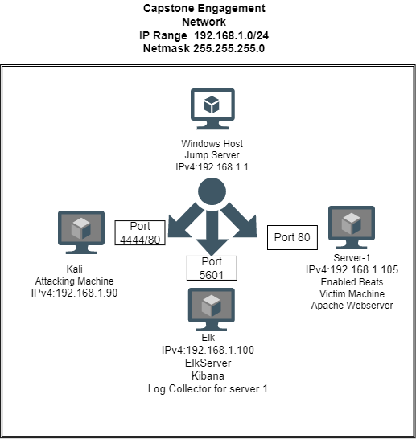
Network Topology
Network
Address Range:192.168.1.0/24
Netmask:255.255.255.0
Gateway:192.168.1.0
Machines
IPv4:192.168.1.90
OS:kali
Hostname:Kali
IPv4:192.168.1.105
OS:Ubuntu 18.04.1 LTS
Hostname:server1
IPv4:192.168.1.100
OS:Linux
Hostname:Elk
IPv4:192.168.1.1
OS:Windows
Hostname:
ML-RefVm-684427

Slide 5

Red Team
Security Assessment
‹#›

Slide 6
Recon: Describing the Target
Nmap identified the following hosts on the network:
Hostname | IP Address | Role on Network
Machines Kali | IPv4:192.168.1.90 | Attacking Machine
Server1 | IPv4:192.168.1.105 | Enabled beats to Elk server Apache Webserver (capstone) Victim machine
Elk | IPv4:192.168.1.100 | Elk Server(Kibana) -Log Collector for server1
Windows Host | IPv4:192.168.1.1 | Jump Server

Slide 7
Vulnerability Assessment
The assessment uncovered the following critical vulnerabilities in the target:
Vulnerability | Description | Impact
Reverse Shell PHP | Allows attacker to gain access to shell on victim’s machine with equal privileges, lets attacker establish a meterpreter session. | You can access files, traverse directories, download content (screenshot, read/write, remote delete files, execute scripts, stop server ).
Weak Passwords | Easily found using password dictionary. | Puts computer and network at risk of being compromised.
Brute Force Login | Login to a password protected directory, by providing a variety of combination | Identity theft, install malware, loss of data, downtime
Port Scan | Used NMAP to scan open ports on the network. | This allowed me to find vulnerable ports so that I could further exploit. (Local file inclusion)

Slide 8
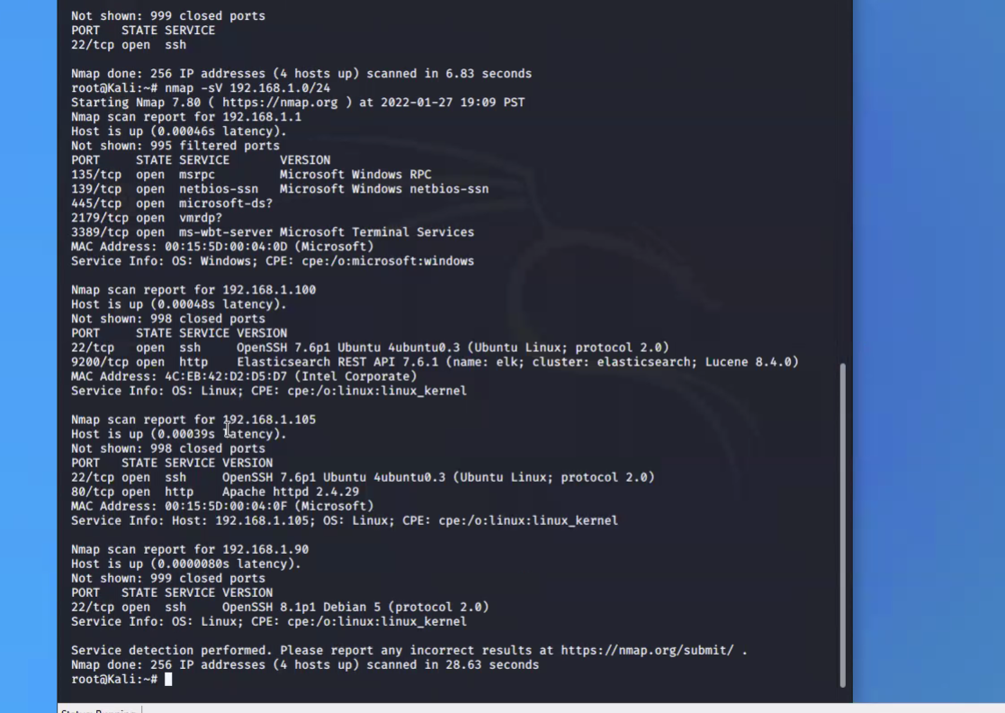
Exploitation: Port Scan
01
02
03
Tools & Processes
In order to find IP address of the machine, I used Nmap to scan network.
Achievements
From Nmap we see that port 80 is open Apache Web Server. I typed IP address in web browser and located hidden directory. I was able to see the content of the server in the browser. It is called local file inclusion.

Slide 9
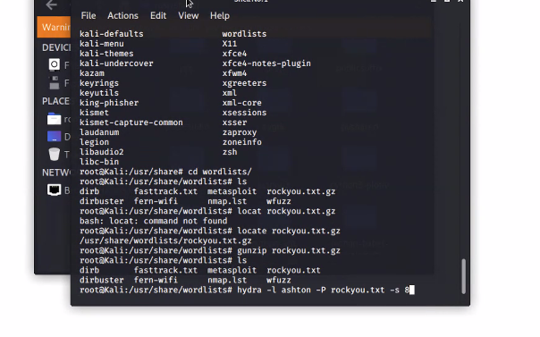
Exploitation: Brute Force
01
02
03
Tools & Processes
Used Hydra attack against directory.
Achievements
I was able to gain privileges through finding username “ashton” and password “leopoldo.”
hydra -l <username> -P <wordlist> -s <port> -f -vV <victim.server.ip.address> http-get </path/to/target>ph192192
hydra -l ashton -P rockyou.txt -s 80 -f -vV 192.168.1.105 http-get /company_folders/secret_folder

Slide 10
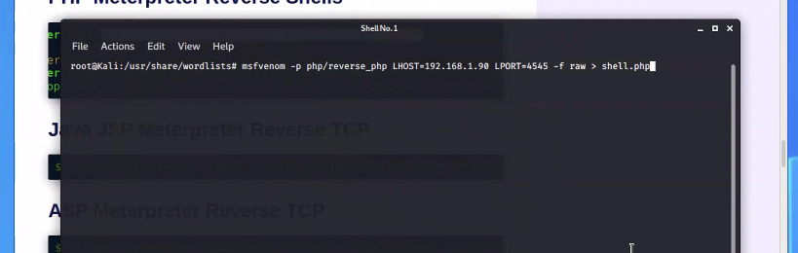
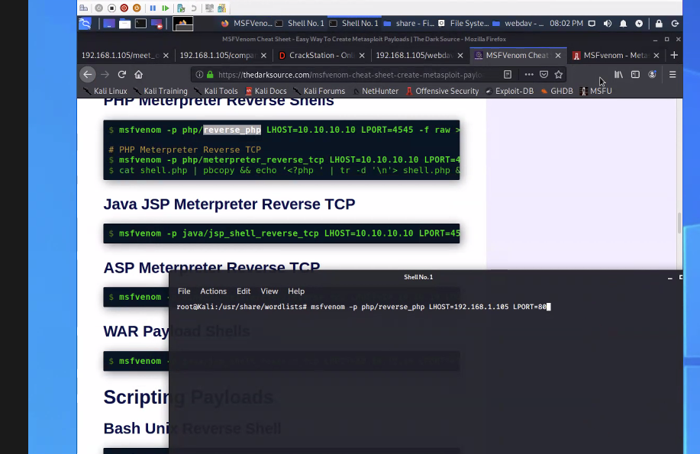
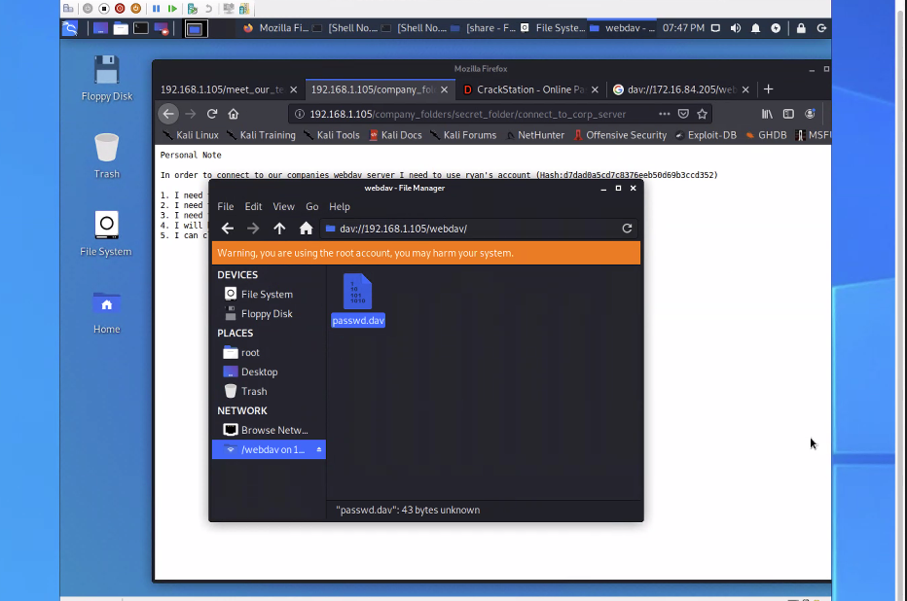
Exploitation: Reverse TCP
01
02
03
Tools & Processes
Using the newly acquired login credentials, I opened a file called “connecting_to_webdav.” In that file I found username and a hashed password. Using CrackStation I solved the hash and gained the resulting password “linux4u.” Next I connected to the VM’s WebDAV directory and entered newly gained credentials.
Achievements
Uploaded PHP reverse shell payload in order to set up a listener command on Meterpreter and uploaded PHP file to WebDAV directory.

Slide 11

Blue Team
Log Analysis and Attack Characterization
‹#›

Slide 12
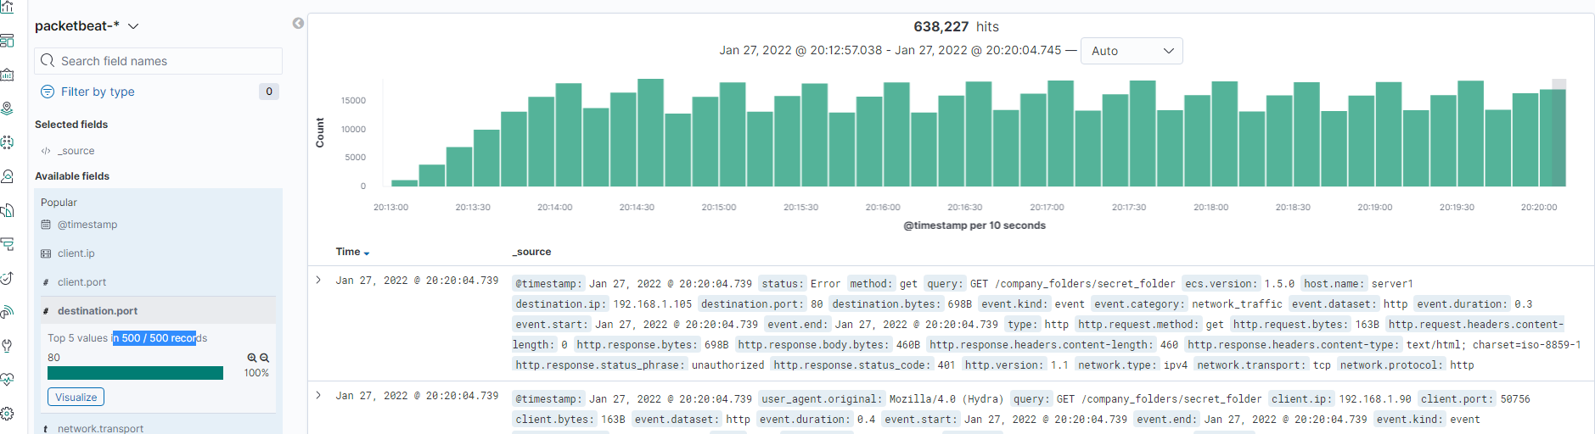
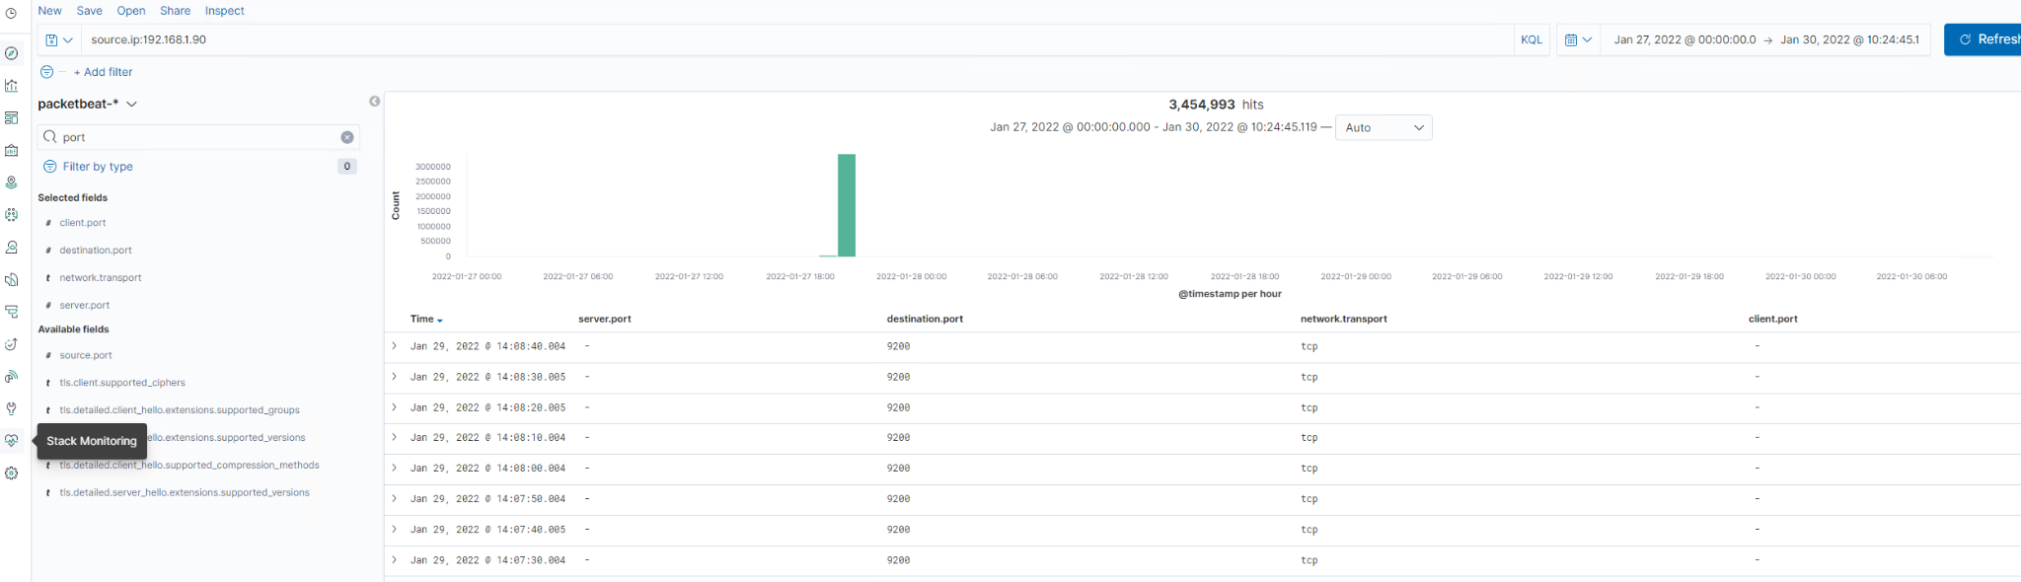
Analysis: Identifying the Port Scan
Port Scan occurred Jan 27, 2022
Source IP 192.168.1.90
The large quantity of scans in a short amount of time indicates an attack

Slide 13
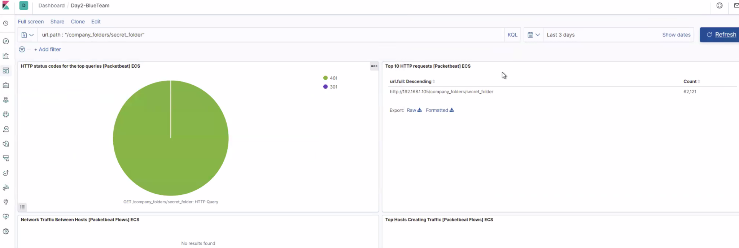
Analysis: Finding the Request for the Hidden Directory
62,121 requests made at 13:20:13
Secret_folder requested containing WebDAV access instructions

Slide 14
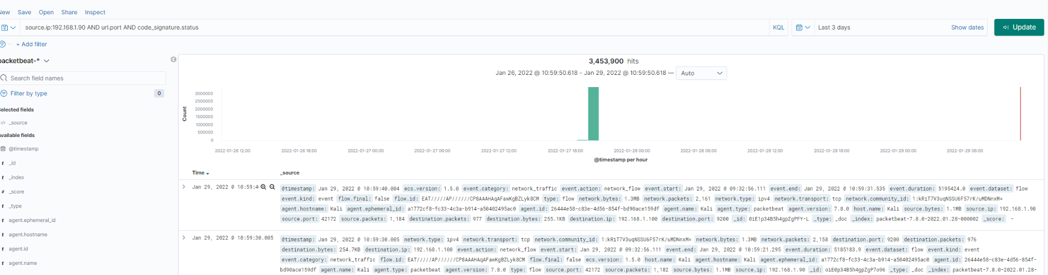
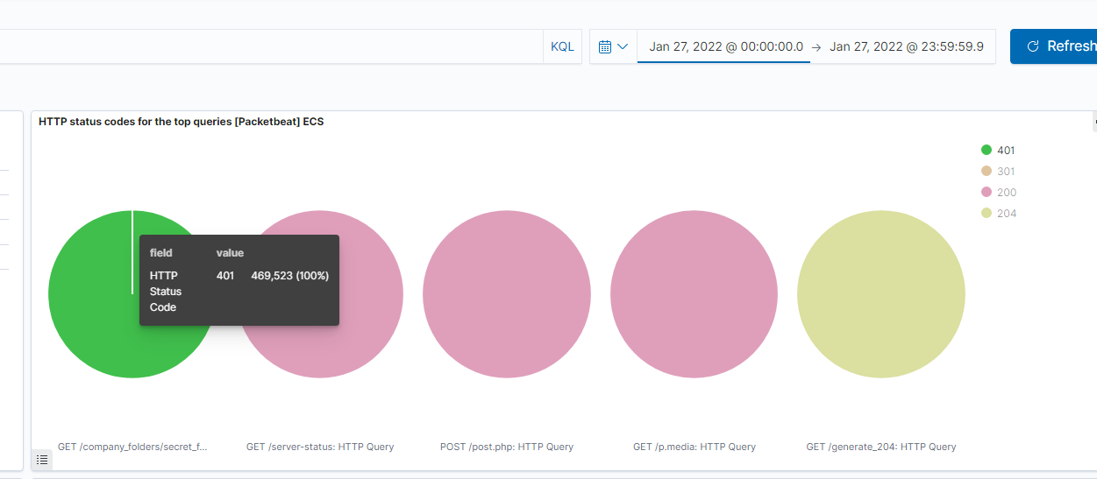
Analysis: Uncovering the Brute Force Attack
3,453,900 Hits
469,523 requests made before the attacker discovered the password
2 requests made after the attacker discovered password

Slide 15
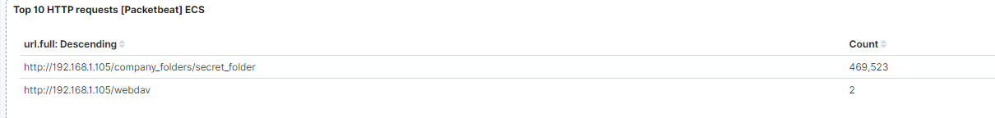
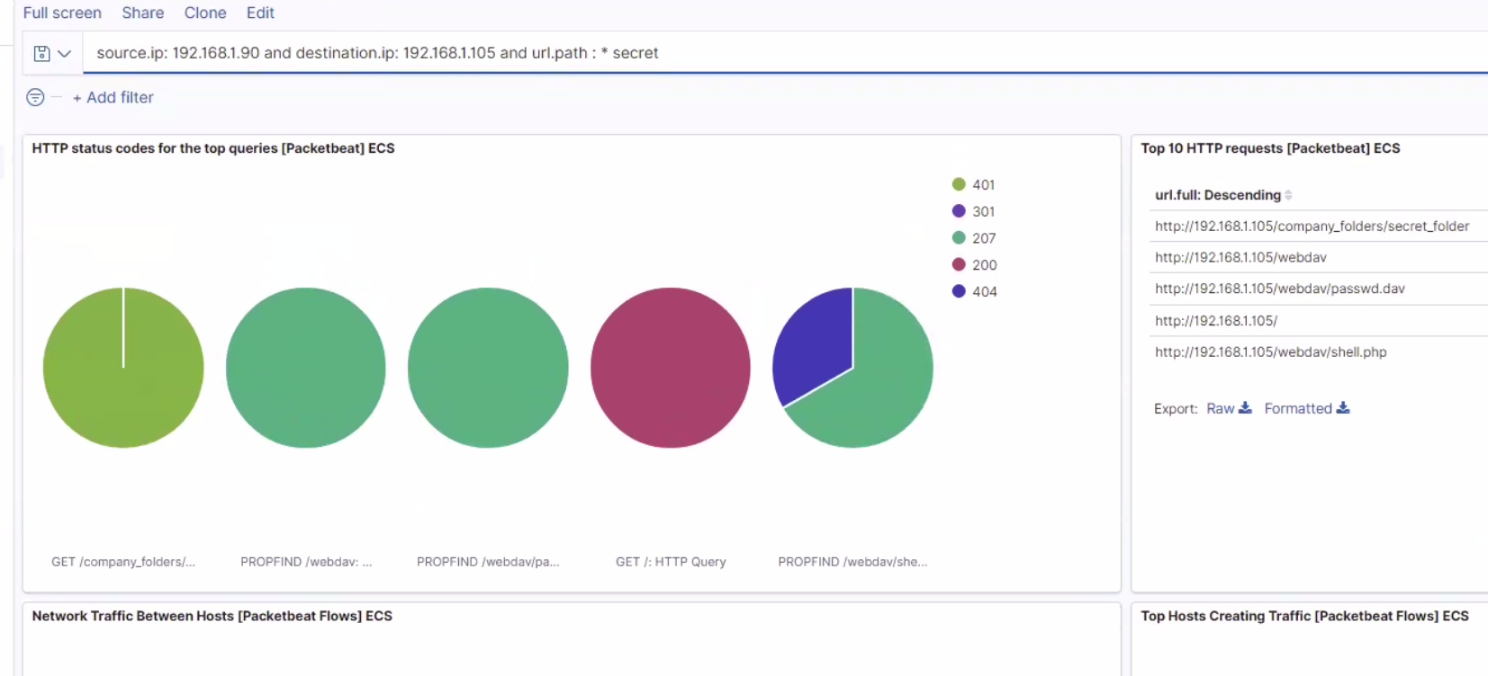
Analysis: Finding the WebDAV Connection
2 WebDAV requests
Shell.php and Passwd.dav requested

Slide 16
Blue Team
Proposed Alarms and Mitigation Strategies
‹#›

Slide 17
Mitigation: Blocking the Port Scan
Create alarm when threshold of 500 ports scanned in 5 minutes occurs.
Set configurations on the host to mitigate port scans by blocking all ports not in use by configuring settings and setting up new rules. In Linux one option is run “sudo apt install firewalld”, “sudo service firewalld status, sudo firewall-cmd - -remove-port=22/tcp
- -permanent”, “sudo firewall-cmd
- -remove-port=22/udp - -permanent,” for example. There are lots of ways to set firewalls and close ports.

Slide 18
Mitigation: Finding the Request for the Hidden Directory
An alarm can be set to detect future unauthorized access when a non-Whitelist IP tries to access network. Set the threshold at 0 in an hour.
Set configuration on the host to block unwanted access by only allowing people from the Whitelist. In Linux you could run from root:
“# iptables -A INPUT -s <ip address> -j ACCEPT”
For all Whitelisted IPs.

Slide 19
Mitigation: Preventing Brute Force Attacks
An alarm can be set to detect future brute force attacks by setting a threshold of 3 failed logins in a minute block. We could also add CAPTCHA and two-factor authentication.
We could add whitelisted IP’s or use BotGaurd. Additionally we could do a lock out after too many failed attempts.
Ex: auth required <account> deny=3 even_deny_root unlock_time=600 oner=fail account required <account>

Slide 20
Mitigation: Detecting the WebDAV Connection
Alarm on non-Whitelisted IP on WebDAV (threshold 1) and make sure my firewall blocks them.
In Ubuntu I would run the following command: $ iptables -A INPUT -s 192.168.1.0/24 -j DROP

Slide 21
Mitigation: Identifying Reverse Shell Uploads
Do not allow upload of code files including PHP (threshold 1). Also trigger alarm for all attempts on port 4444.
Set access to read only and have whitelisted IPs. Also ensure that only necessary ports are open.

